Slide 1


Migrating to Angular via ng-metadata

Slide 2


Welcome to Panaya
A SaaS company
Leading the area of impact and risk analysis to ERP systems
Integrating with Salesforce, ServiceNow, SAP, Oracle ERP
Agile workflow tool for IT And development teams
We’re hiring!

Slide 3
The Front-End and Me

Slide 4

Our Story Begins…
Running AngularJS 1.4
ECMAScript 5
No Webpack, No NPM

Slide 5
Code
https://github.com/kampana/ng-metadata-migration/tree/master

Slide 6

Lets upgrade

Slide 7
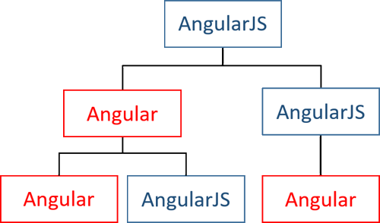
After several months…

Slide 8

Upgrade and Downgrade

Slide 9

Until one day…

Slide 10
The Show Stopper
core.es5.js?de3d:1020 ERROR Error: [$rootScope:inprog] http://errors.angularjs.org/1.4.3/$rootScope/inprog?p0=%24digest
at angular.js:38
at r (angular.js:16200)
at n.$digest (angular.js:15637)
at eval (static.es5.js?fadf:1321)
at SafeSubscriber.schedulerFn [as _next] (core.es5.js?de3d:3647)
at SafeSubscriber.__tryOrUnsub (Subscriber.js?9a65:238)
at SafeSubscriber.next (Subscriber.js?9a65:185)
at Subscriber._next (Subscriber.js?9a65:125)
at Subscriber.next (Subscriber.js?9a65:89)
at EventEmitter.Subject.next (Subject.js?104a:55)

Slide 11
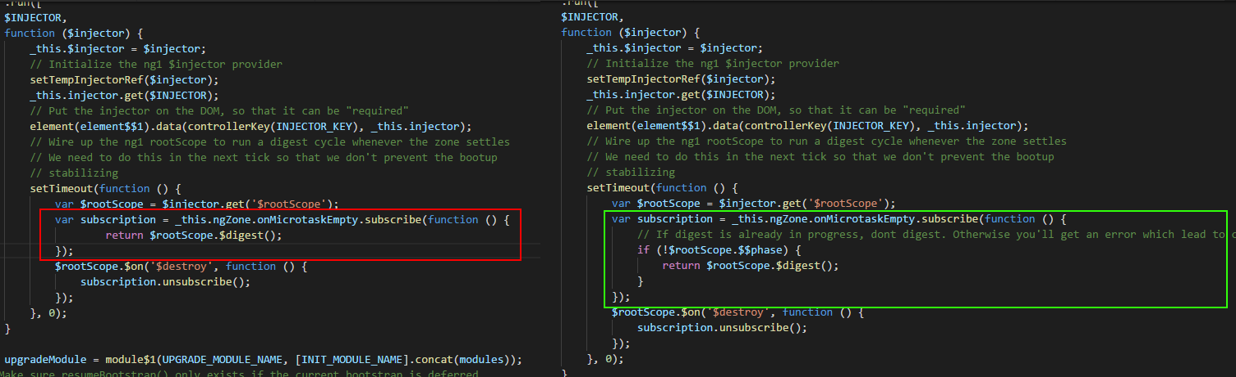
@angular/upgrade/static.es5.js

Slide 12


Slide 13




We Gained

Slide 14
Code
https://github.com/kampana/ng-metadata-migration/tree/Phase-1---JS-with-Webpack

Slide 15

Let’s decouple from the framework

Slide 16

Introducing
ng-metadata
https://github.com/ngParty/ng-metadata
Thanks Dima Abramovich! ☺

Slide 17
Code
https://github.com/kampana/ng-metadata-migration/tree/Phase-2---JS-with-TS
https://github.com/kampana/ng-metadata-migration/tree/Phase-3---JS-with-JS-using-TS
https://github.com/kampana/ng-metadata-migration/tree/Phase-4---All-TS
https://github.com/kampana/ng-metadata-migration/tree/Phase-5--Angular-5

Slide 18
To Sum Up
Upgrade alternatives
IFrame
UpgradeModule / DowngradeModule
Ng-metadata

Slide 19
Thank you

